Slide 1

Phase I – Operational Planning
Notes:
Instructor Notes:
- Introduction Slide

Slide 2
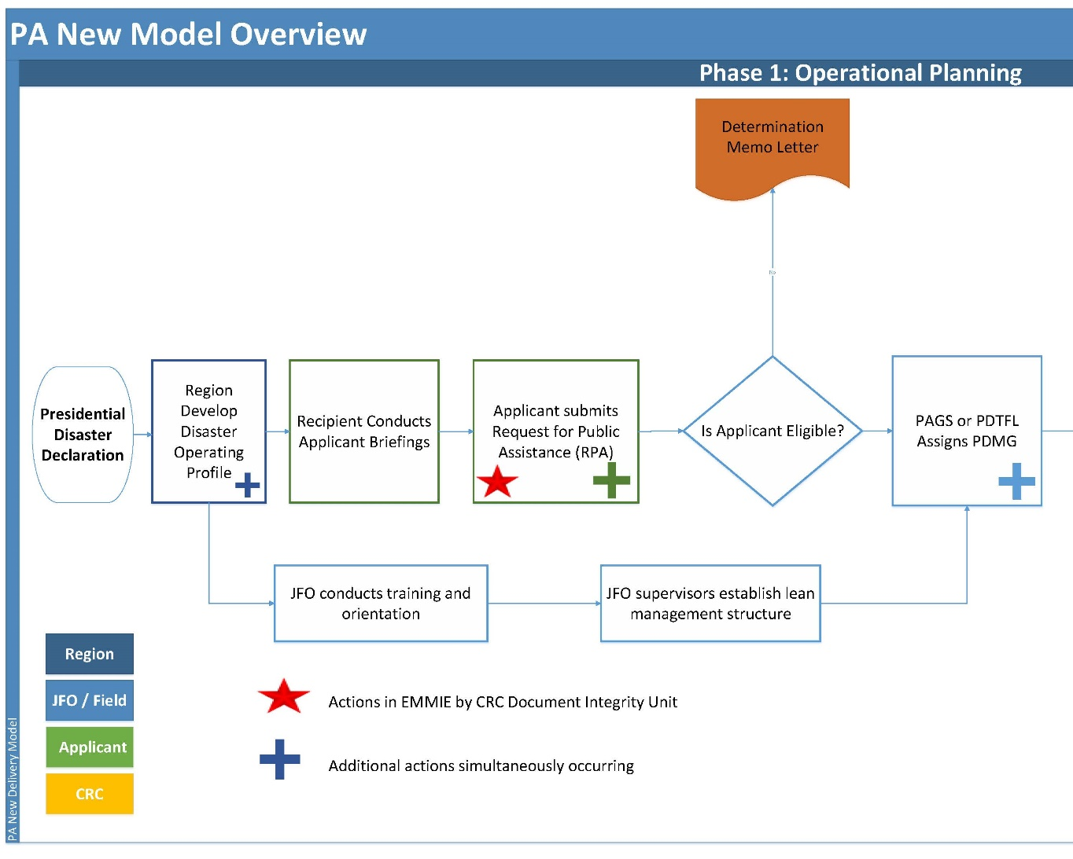
Phase I – Operational Planning
Action Items
Notes:
Instructor Notes:
- Begin with an orientation to the Phase I steps. Each step will be broken down into components, roles and details through the following slides in the Unit.

Slide 3
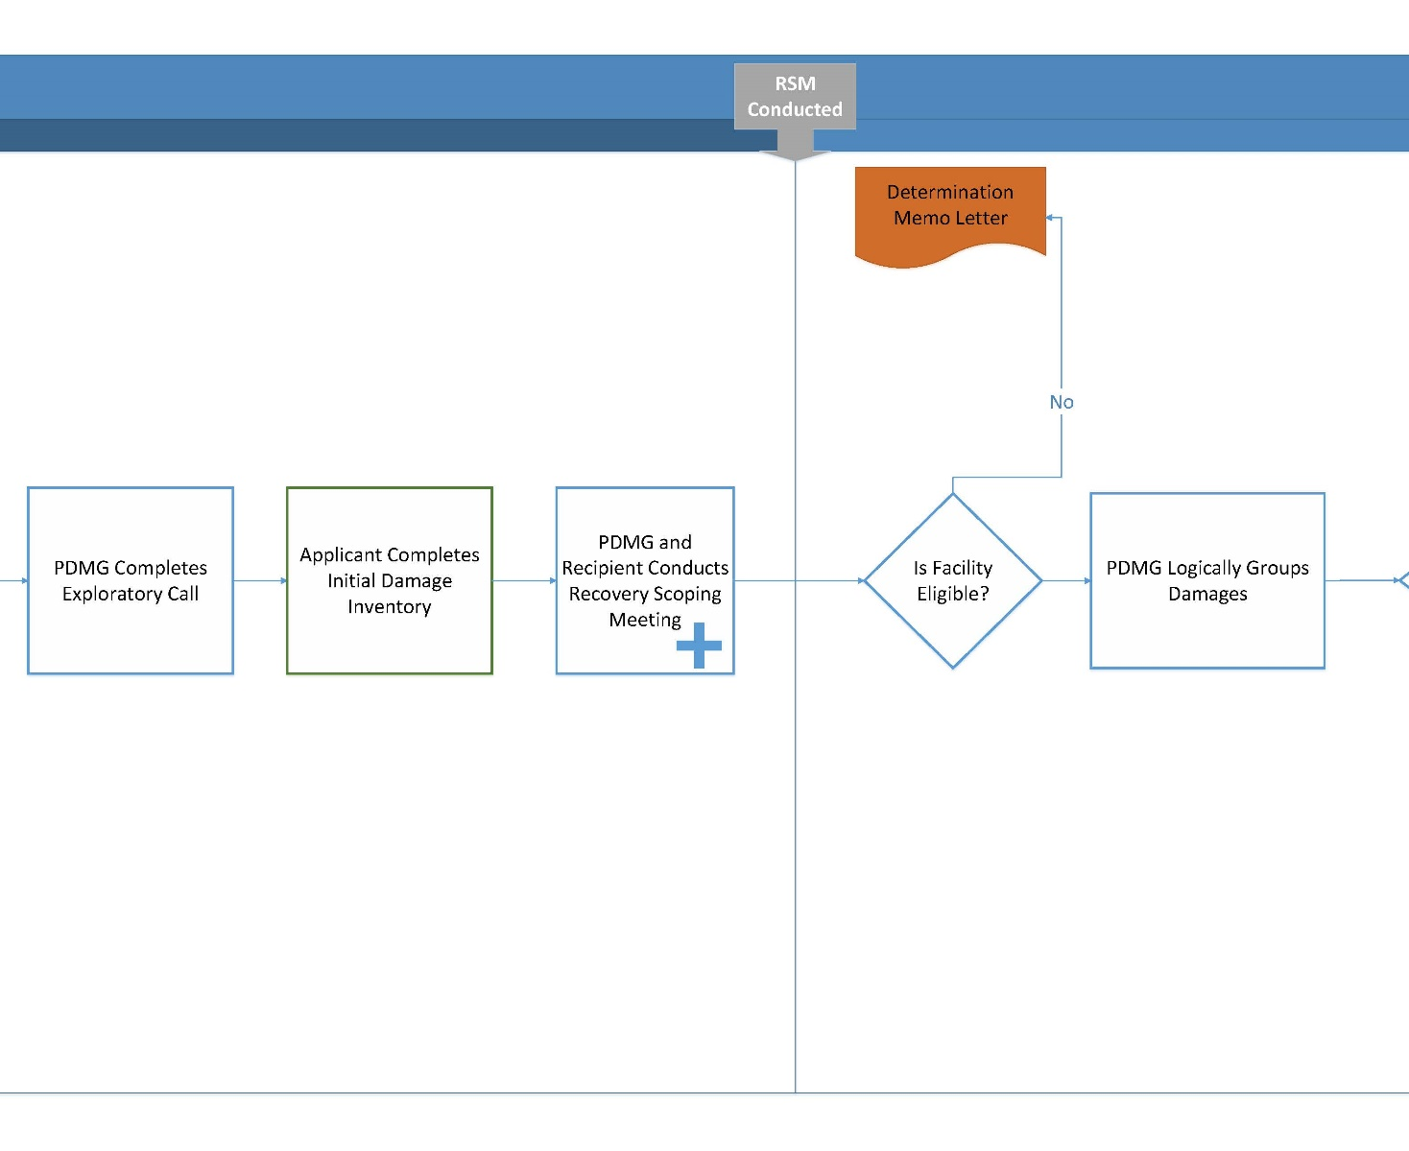
Phase I – Operational Planning
Action Items
Notes:
Instructor Slide:
- Similar to previous slide, but show the transition phase. Inform the class that Phase II will be discussed in detail through the next Unit.

Slide 4
Phase I – Operational Planning
Action Items
Who is the Recipient?
Advocate to the Applicant
Manages the reimbursement of FEMA obligated Public Assistance Grants
Facilitates PA Grants Management throughout the disaster lifecycle
May be a State Government, Tribal Government, or United States Territory
Notes:
Instructor Note:
- Highlight the bullet points and have discussion as necessary.

Slide 5
Phase I – Operational Planning
Action Items
Who is the Applicant?
Local Government, Special Tax District, Private Non-Profit, State Government, Tribal Government, or United States Territory
Responsible for the work and cost of disaster related damages
May potentially be eligible for funding within the FEMA PA Program
Notes:
Instructor Note:
- Highlight the bullet points and have discussion as necessary.

Slide 6
Phase I – Operational Planning
Action Items
Step 1: The Joint PDA (1/4):
First step in the Presidential declaration process
FEMA/Applicant/Recipient work together to verify damage
FEMA Damage Assessment Teams are specialized to the task
Fast Paced/Preliminary: PDA Teams do not inspect 100% of damages
Applicants should target their most significant damages in assessment planning
Notes:
Instructor Note:
- Highlight the bullet points and have discussion as necessary.

Slide 7
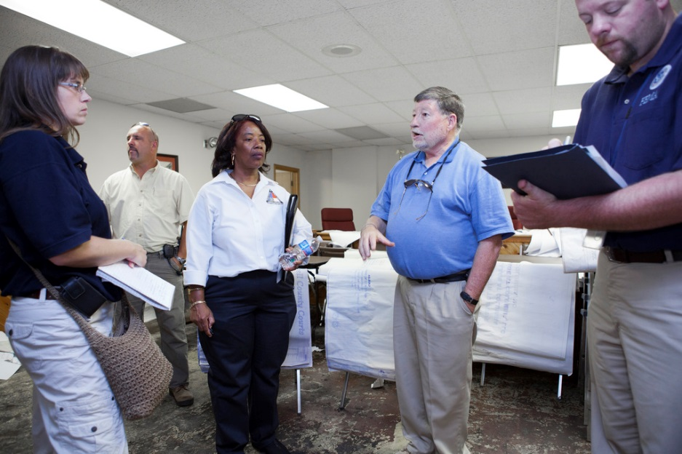
Phase I – Operational Planning
Action Items
Step 1: The Joint PDA (2/4):
PRELIMINARY DAMAGE ASSESSMENT VIDEO:
https://www.youtube.com/watch?v=Lad02ENb44o
Notes:
Instructor Notes:
- Show the Video to the class by clicking the link.

Slide 8
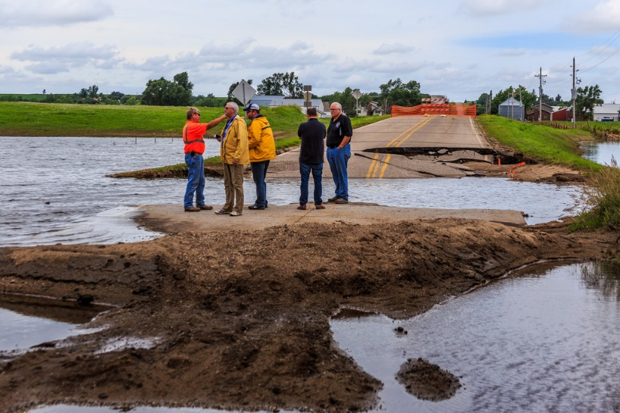
Phase I – Operational Planning
Action Items
Step 1: The Joint PDA (3/4):
Applicants should be prepared to show:
Disaster damage
Disaster Photos
Annotated damage map
Any available costs
Provide available local costs
Notes:
Instructor Note:
Highlight the bullet points and have discussion as necessary.
(If Possible and due to applicant capabilities) Emphasize the importance for applicants to take photos and GPS coordinates of their damaged sites, such as, CAT B (barricading roads). Also important to take post photos of sites that are 100% completed work.

Slide 9
Phase I – Operational Planning
Action Items
Step 1: The Joint PDA (4/4):
Activity:
Locate the FEMA Damage Assessment and Operations Manual Online
Save a copy to your laptop
Notes:
Instructor Note:
Inform students that the Manual is being downloaded for use in the class now, and for future referral in disaster events.
Guide the class through the key components. Define Applicant and Recipient roles throughout the overview.
Link: https://www.fema.gov/media-library/assets/documents/109040

Slide 10
Phase I – Operational Planning
Action Items
Step 2: Region develops Disaster Operating Profile (1/2)
Developed from the Preliminary Damage Assessment
Profile continues to evolve as more information is learned
  Type of peril
  State, Local Tribe, or Territory Capacity
  Primary Event Impacts
  Estimated damage by Work Category
  Significant Damages
  Geographic Considerations
  Number of Potential Applicants
  Number of Potential Projects
  Special Considerations Challenges
  Mitigation Opportunities
  Potential involvement by Other Federal Agencies (OFA)
Notes:
Instructor Note:
- Highlight the bullet points and have discussion as necessary.

Slide 11
Phase I – Operational Planning
Action Items
Step 2: Region develops Disaster Operating Profile (2/2)
Joint Field Office / Area Field Office Considerations
FEMA Initial Staffing Considerations include:
  Scope of Disaster
  Geographical Area
  Magnitude of Impacts
  Types of Damage
  Types of Specialties Required
  Staff Support Needed for Mission
Notes:
Instructor Note:
- Highlight the bullet points and have discussion as necessary.

Slide 12
Phase I – Operational Planning
Action Items
Step 3: Applicant Briefings
Post Disaster Declaration
Facilitated by the Recipient
Upon request, FEMA Staff attends to support the Recipient
Recipients assist Applicants in submitting the Request for Public Assistance (RPA) during this meeting (via Grants Portal)
Applicants can submit RPA anytime up to 30 days post-declaration in Public Assistance Grants Portal.
Notes:
Instructor Note:
- Highlight the bullet points and have discussion as necessary.
Submittal of an RPA is essential to receiving Public Assistance Grant Funding.
Process: PDA, Govern request, 204, Presidential Declaration, 424, RPA, Applicant Briefings

Slide 13
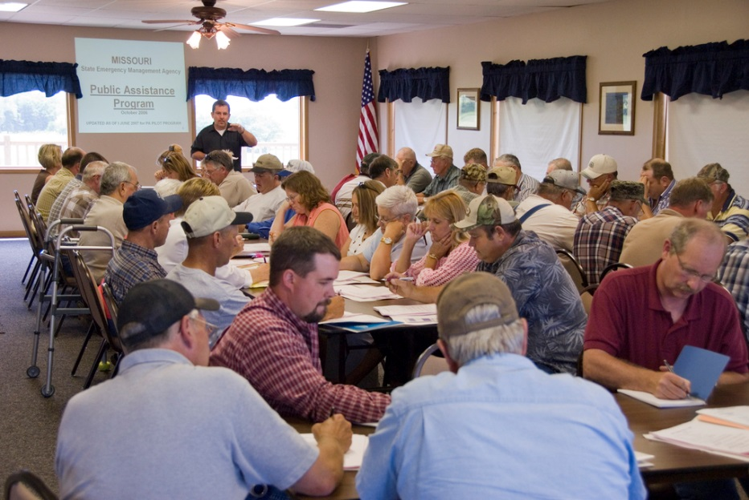
Phase I – Operational Planning
Action Items
Step 3: Applicant Briefings – Continued
APPLICANT BRIEFING VIDEO https://www.youtube.com/watch?v=8AEvbfLRUJE&feature=youtu.be
Notes:
Instructor Notes:
- Show the Video to the class by clicking the link.

Slide 14
Phase I – Operational Planning
Action Items
Step 4: Request for Public Assistance (RPA)
In order to receive funds, the Applicant must submit the RPA.
The Applicant should designate an Applicant Agent, Alternate and physical address.
  If the Finance Director will be the Applicant Point of Contact, the Mayor should not be listed.
  If the Applicant Agent is based out of the Public Works Yard, reflect that address.
Notes:
Instructor Note:
- Highlight the bullet points and have discussion as necessary.

Slide 15
Phase I – Operational Planning
Action Items
Step 4: Request for Public Assistance (RPA)
Private Non-Profits are required to submit copies of additional paperwork:
Tax Exemption Certificate
Latest Tax Return
Organizational Charter or By-Laws
School Organizations must submit Accreditation or Certification
Notes:
Instructor Note:
- Highlight the bullet points and have discussion as necessary.

Slide 16
Phase I – Operational Planning
Action Items
Step 4: Request for Public Assistance (RPA)
In the New PA Delivery Model, Applicants will have RPA capability within the Public Assistance Grants Portal.
In consideration: RPAs Must be Submitted Within 30 Days of the Presidential Disaster Declaration.
If experiencing difficulty in submitting the RPA, contact your Recipient for assistance.
Notes:
Instructor Note:
- Highlight the bullet points and have discussion as necessary.

Slide 17
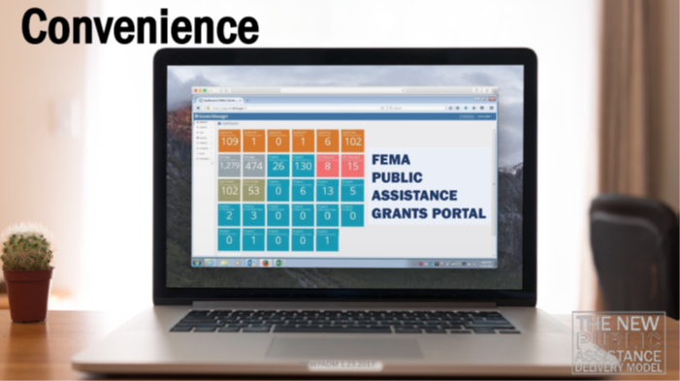
Phase I – Operational Planning
Action Items
Step 4: Request for Public Assistance (RPA)
Grants Portal – Submitting the RPA

Slide 18
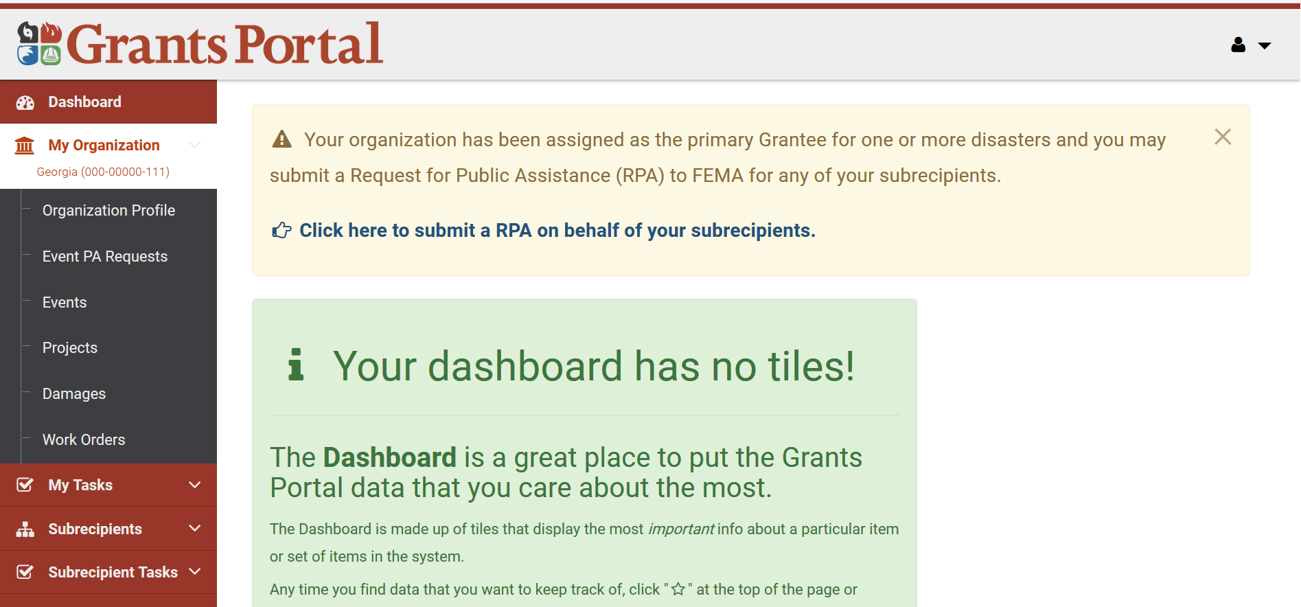
Request for Public Assistance - RPA
C
Notes:
Recipient starting a Request for Public Assistance (RPA) for a Sub-Grantee (Applicant) from their dashboard.
The Sub-Grantee (Applicant will also have the ability to apply for an RPA within their own account.

Slide 19
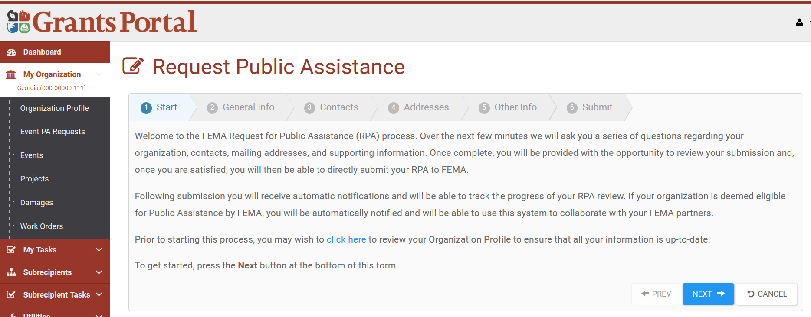
Request for Public Assistance - RPA

Slide 20
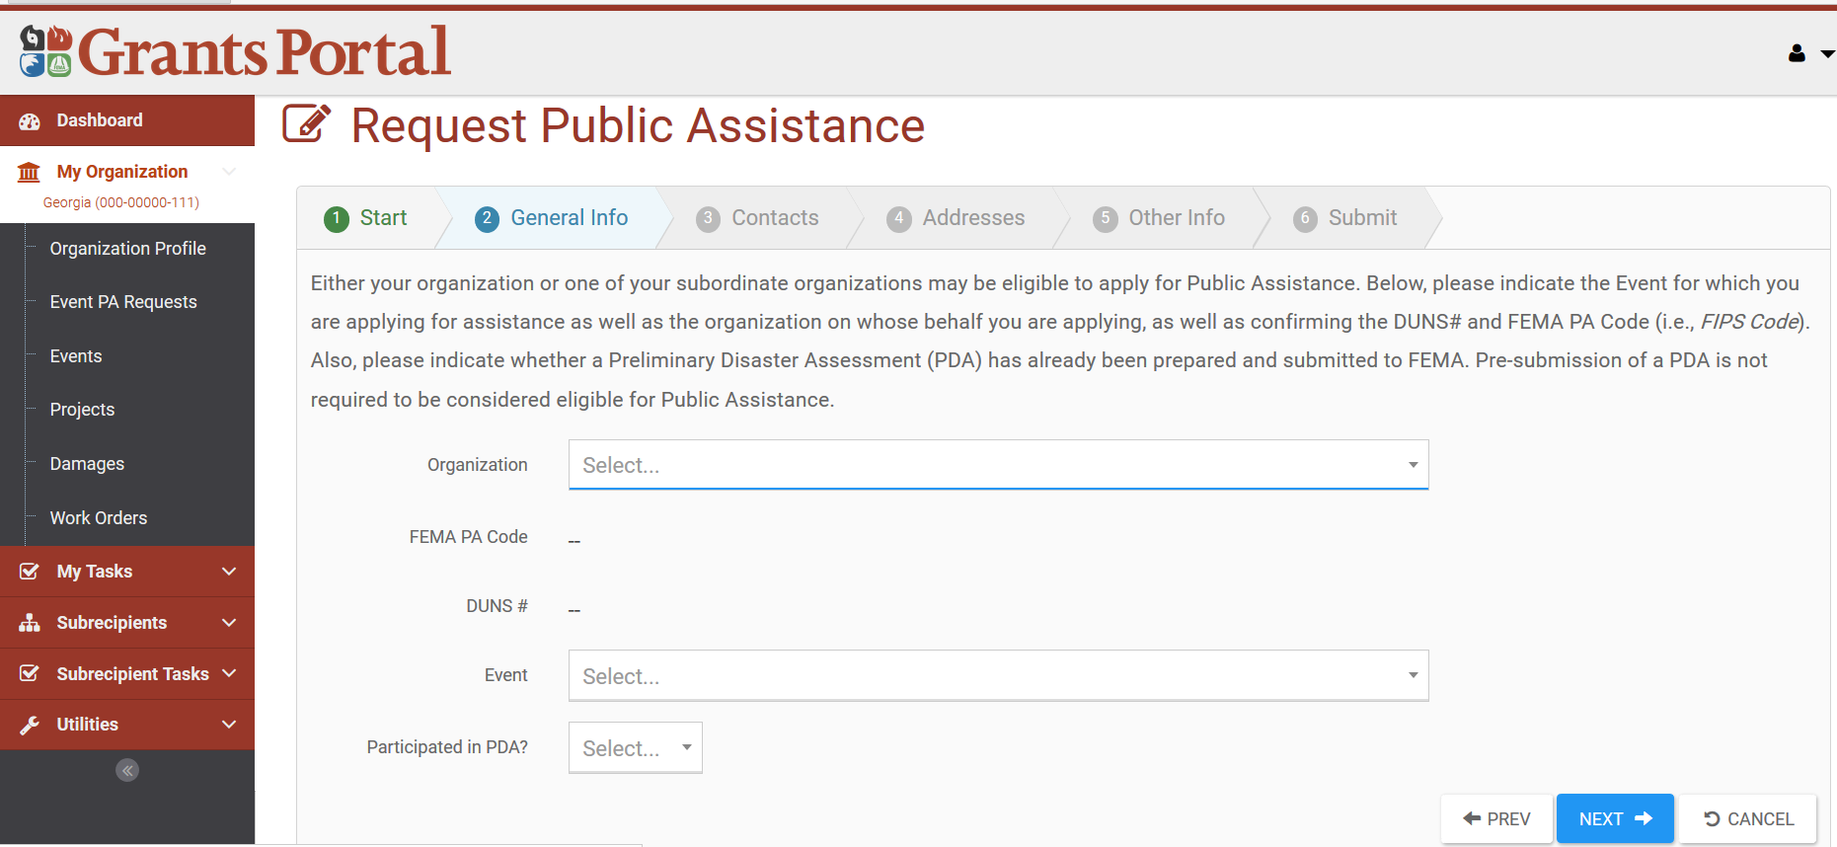
Request for Public Assistance - RPA
Notes:
Recipient fills in Organization information.

Slide 21
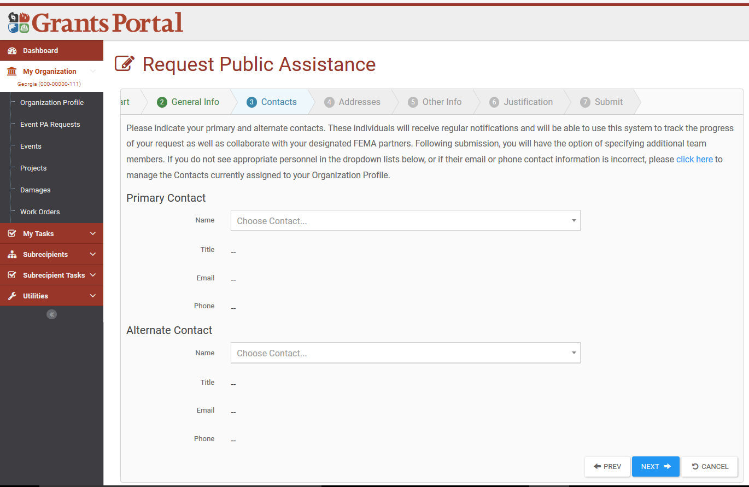
Request for Public Assistance - RPA
Notes:
Contact information auto populates from the Organization profile; just select a name(s) from the drop downs.

Slide 22
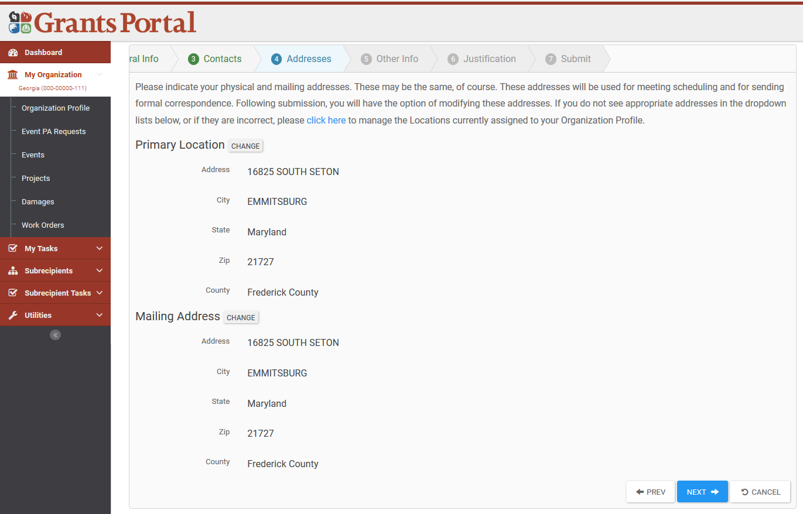
Request for Public Assistance - RPA
Notes:
Addresses can be change is they do not want to use the ones that are auto populated from the Organization Profile.

Slide 23
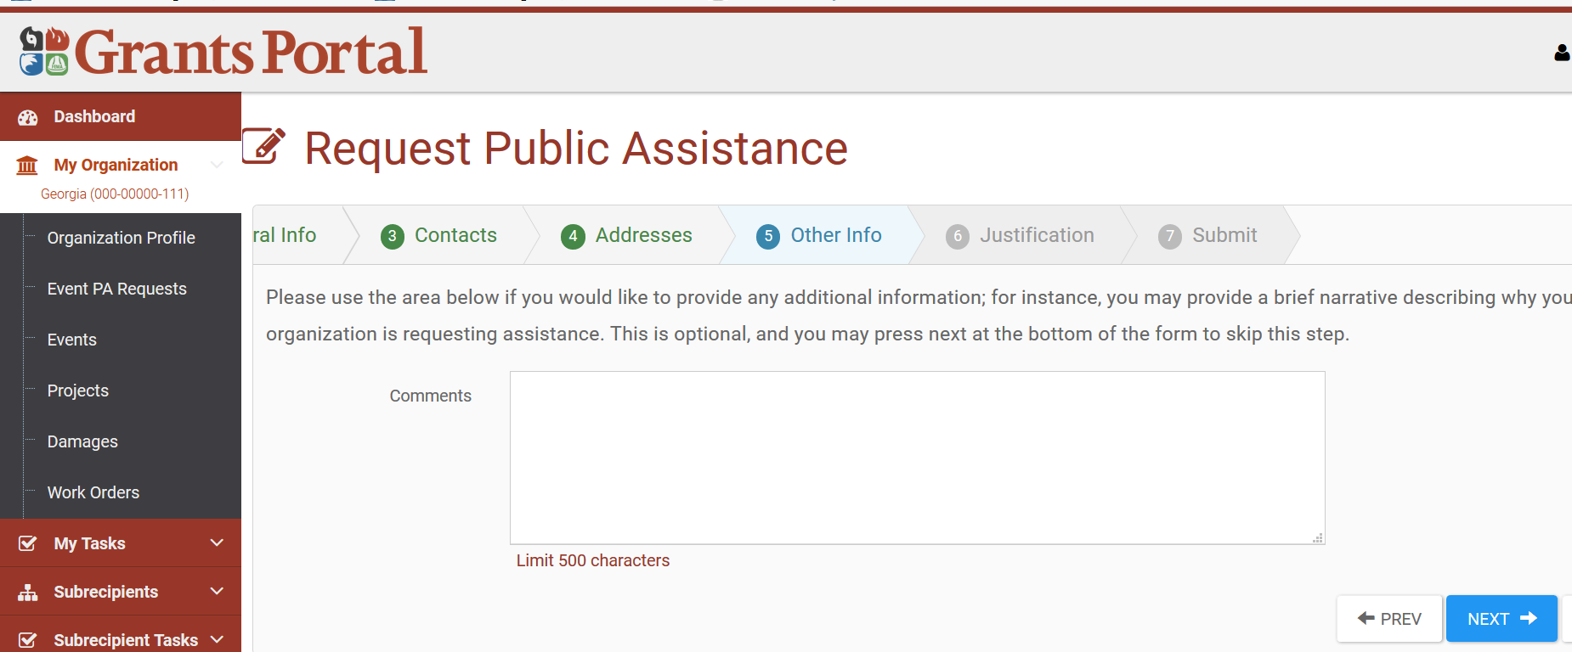
Request for Public Assistance - RPA
Notes:
General Comments can be entered.

Slide 24
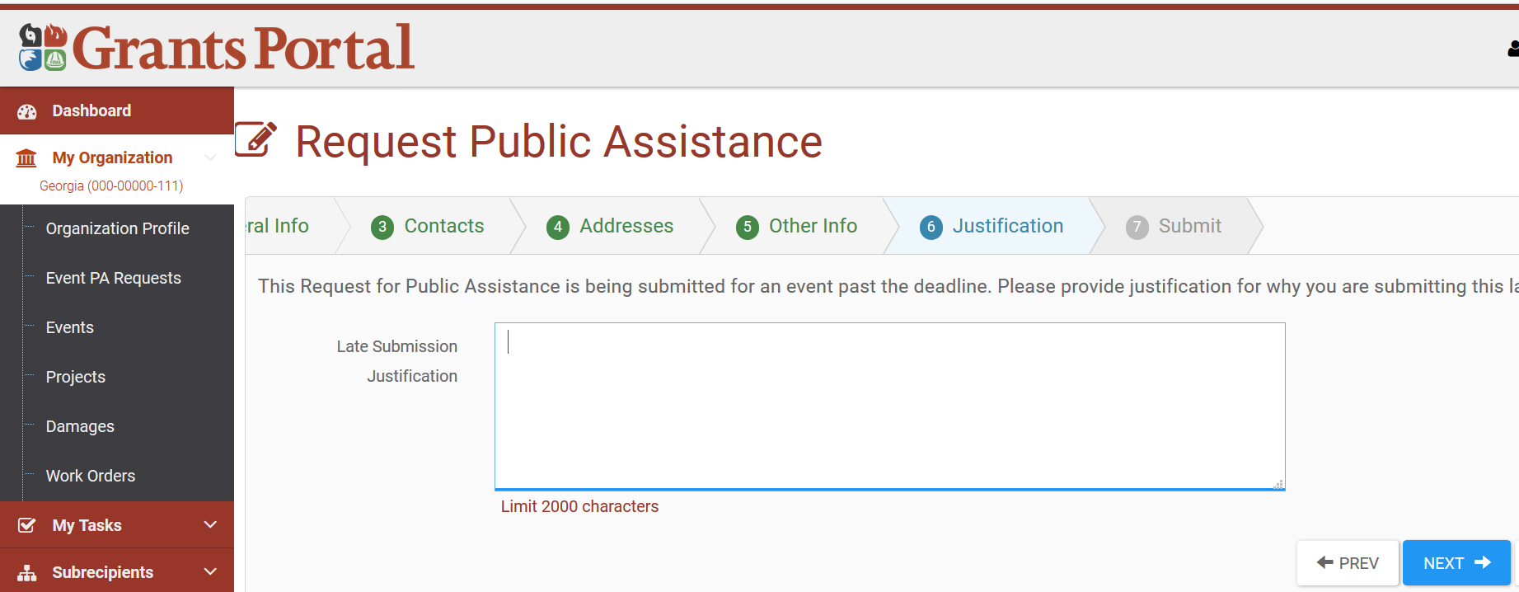
Request for Public Assistance - RPA
Notes:
If it is a late submission after the RPA deadline a Justification is required.

Slide 25
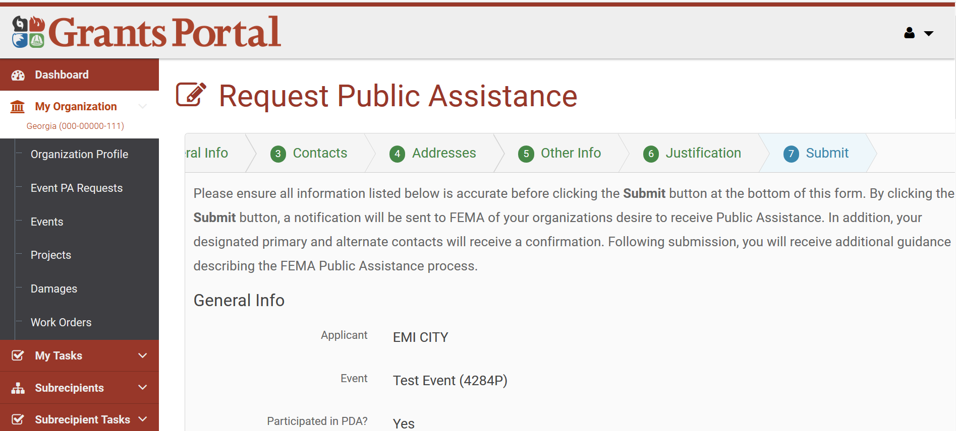
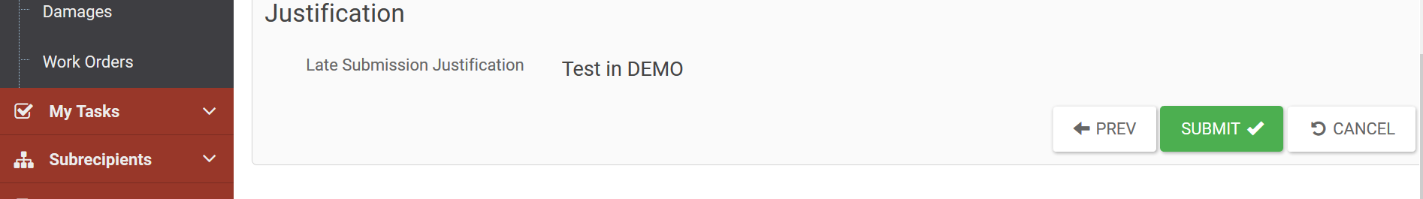
Request for Public Assistance - RPA
Notes:
Verify all the information before submitting

Slide 26
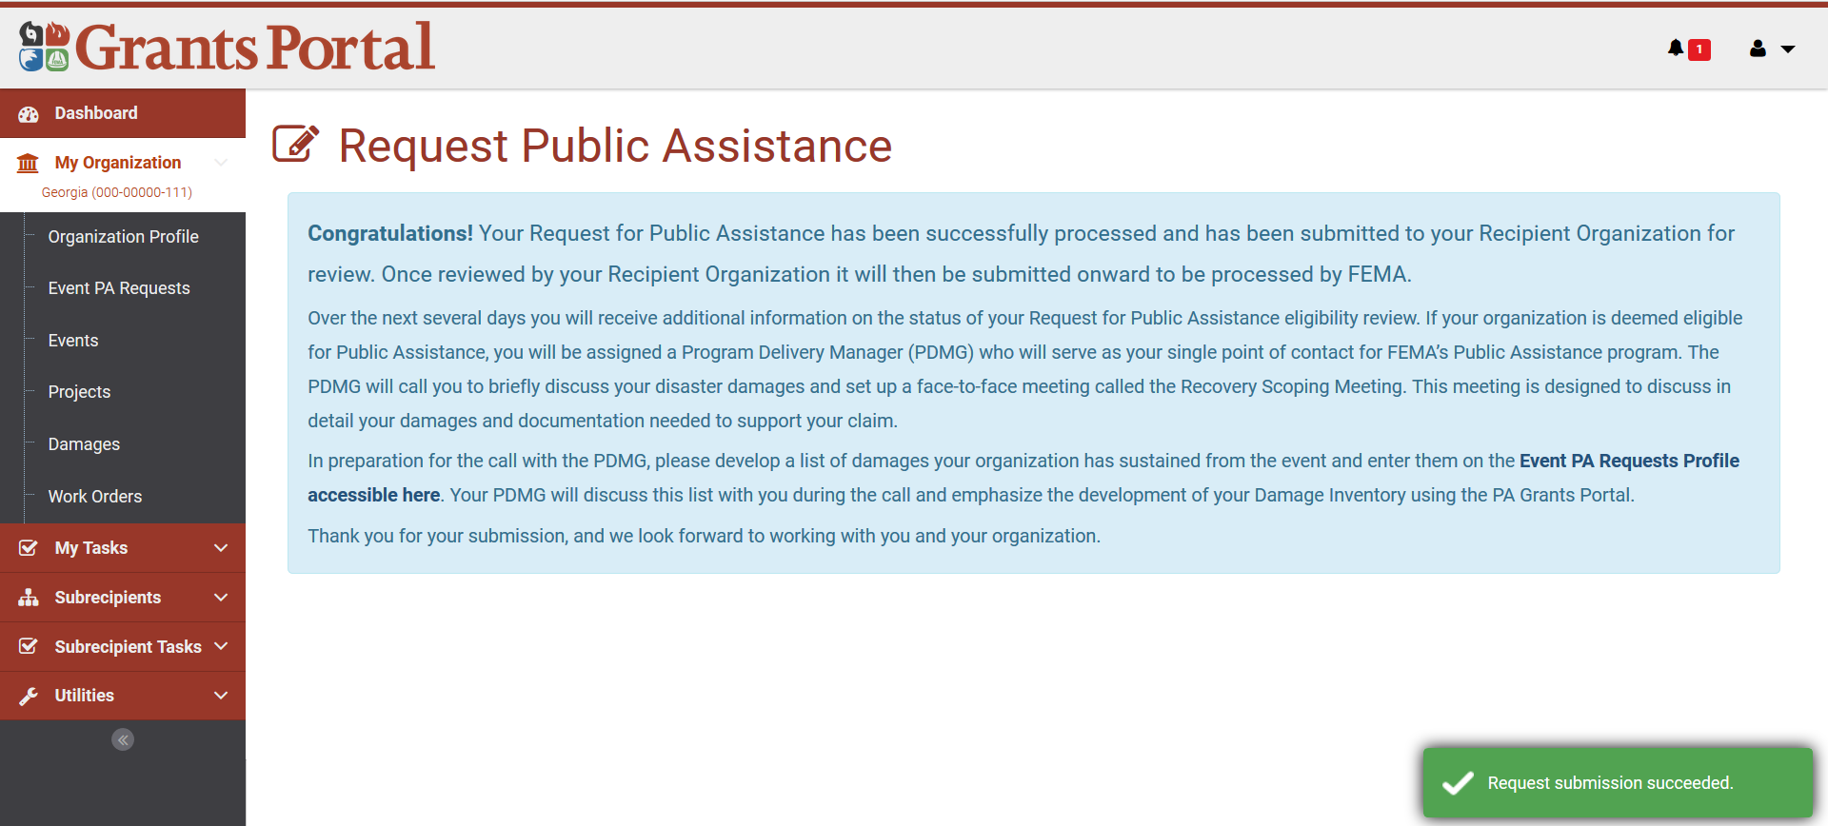
Request for Public Assistance - RPA
Notes:
Depending on their IT settings they may not be able to receive outside emails. They may need to check with their IT and ensure that email from pagrants.fema.gov is allowed. Most emails come from support@pagrants.fema.gov.

Slide 27
Phase I – Operational Planning
Action Items
Step 5: Applicant Eligibility Determinations
Following Submittal of the RPA, Recipient will review
The Recipient ensures all components of the RPA are complete
Recipient forwards RPA through Grants Portal to the State for Eligibility
FEMA Field Leadership determines Applicant Eligibility
The Grants Portal will generate an email notification upon an RPA eligibility determination.

Slide 28
Phase I – Operational Planning
Action Items
Step 5: Applicant Eligibility Determinations
Eligibility Determinations are made in accordance with:
FEMA Public Assistance Program and Policy Guide (PAPPG) Pages 10-15
The Stafford Act
42 United States Code
2 Code of Federal Regulations
44 Code of Federal Regulations

Slide 29
Phase I – Operational Planning
Action Items
Step 5: Applicant Eligibility Determinations
Activity:
Locate the FEMA Public Assistance Program and Policy Guide (PAPPG) Online.
Save a copy to your laptop.
Within the PAPPG → Examine the Publication, as a group, discuss any findings you did not know.
10 Minute exploration → Followed by 5 minute discussion.
Notes:
Instructor Notes:
Allow 10 minutes for the class to complete the Activity.
Engage in a 5 Minute Class Discussion.
https://www.fema.gov/public-assistance-policy-and-guidance

Slide 30
Phase I – Operational Planning
Action Items
Step 6: The FEMA Program Delivery Manager (PDMG) is assigned to the Applicant
All efforts of the Program Delivery Manager are directed at assisting the Applicant.
Serves as the Primary Point of Contact.
Coordination to insure that Applicant and Consolidated Resource Center needs are met.
Works to resolve any additional unmet needs.
Notes:
Instructor Notes:
Expand upon each bullet point of the slide.

Slide 31
Phase I – Operational Planning
Action Items
The FEMA Program Delivery Manager (PDMG)
Expected to meet and communicate with their assigned Applicants as often as necessary.
Recipient may coordinate with the PDMG to:
  Partner with and mirror the PDMG
  Attend all meetings between Applicants and PDMGs
  Serve as Applicant Advocate
  Assist with the collection of documentation
Notes:
Instructor Notes:
- Expand upon each bullet point of the slide.

Slide 32
Phase I – Operational Planning
Action Items
The FEMA Program Delivery Manager (PDMG)
Applicant interface begins with the Exploratory Call.
Proceeds through the development of Damage Inventory and Document Collection.
Executes the Recovery Scoping Meeting.
Facilitates the meetings between the Applicant and FEMA as necessary.
Coordinates applicant concurrence.
Notes:
Instructor Notes:
- Expand upon each bullet point of the slide.

Slide 33
Phase I – Operational Planning
Action Items
Step 6: Project Delivery Manager (PDMG) Assigned
Activity - The Program Delivery Manager Position Assist.
Notes:
Instructor Notes:
Have the Participants open the Position Assist.
Orient the Audience with the Assist and it’s importance as a job aid tool.
Highlight the key components and discuss the PDMG Roles throughout.

Slide 34
Phase I – Operational Planning
Action Items
Step 7: The Exploratory Call
PDMG AND EXPLORATORY CALL VIDEO
https://www.youtube.com/watch?v=rjZiJiBrTXU&feature=youtu.be
Notes:
Instructor Notes:
- Show the Video to the class by clicking the link.

Slide 35


Phase I – Operational Planning
Action Items
Step 7: The Exploratory Call
OCCURS WITHIN 7 DAYS
EXPLORATORY CALL

Slide 36
Phase I – Operational Planning
Action Items
The Exploratory Call
The initial call/ Introduction with the applicant
Facilitated by the Program Delivery Manager
PDMG becomes familiar with the Applicant, their needs, and how they have been impacted.
Types of disaster damage are discussed with the Applicant
Call creates tailored agenda for the Recovery Scoping Meeting
The date, time and meeting location of the Recovery Scoping Meeting (RSM) is set.
Notes:
Instructor Notes:
Review the bullet points and answer any questions.

Slide 37
Phase I – Operational Planning
Action Items
The Exploratory Call (Continued)
During the Call, a variety of considerations will be addressed:
  Are the damages understood / known by Applicant?
  Damage Inventory Development
  Potential FEMA Participants at RSM
  Potential Applicant Participants at RSM
  Essential Paperwork to bring to the RSM
  Possible Mitigation or Environmental and Historic Preservation Involvement
Notes:
Instructor Notes:
Inform the Audience that timely identification of damage is critical to the Delivery Model
FEMA will need to consider potential staff to bring to the Recovery Scoping Meeting to include Mitigation and/or EHP Specialists.
Applicants will need to identify the participants they will bring to the meeting. Applicants should identify personnel who will work with the document collection and site inspection process (Examples: Highway Engineer, Public Works Director, Parks Director, Etc.)
Emphasize the benefits of having the Damage Inventory completed before the RSM (not required but at least have it started).
Explain how having a good detailed damage description in the Damage Inventory will help inform the Site Inspector on the damaged site(s) before the site inspection.
Inform the Audience that PDMG will get an idea of the applicant’s capabilities during EC, such as, having access to the Grants Portal and able to download the Damage Inventory sheet.

Slide 38
Phase I – Operational Planning
Action Items
The Exploratory Call (Continued)
Exploratory Call Participants:
  FEMA Program Delivery Manager (PDMG)
  FEMA 406 Mitigation
  FEMA Environmental and Historic Preservation
  The Applicant
  The Recipient
Notes:
Instructor Notes:
Stress to the Audience that Recipient engagement, participation and partnership is critical to the success of Public Assistance Delivery. The Exploratory Call is a FEMA function, but engagement and presence of the Recipient is encouraged throughout the process. Recipients are invited to participate in the call through this partnership.
Enforce that transparency, partnership and communication is key to the success of the New Delivery Model

Slide 39
Phase I – Operational Planning
Action Items
The Exploratory Call (Continued)
Activity – Exploratory Call Guide and Checklist
Notes:
Instructor Notes:
Have the Participants open the Guide.
Highlight key components and inform the Audience the guide is provided for Applicant/Recipient visibility and future disaster planning.
Special Instructor Note: The guide is rather lengthy and for time considerations of the course, this slide should represent an orientation and visibility to the guide. At a later time, attendees will have an opportunity to review the guide in detail, and retain as a reference on future disasters in preparation for an Exploratory Call.

Slide 40
Phase I – Operational Planning
Action Items
The Exploratory Call (Continued)
Following the Exploratory Call, the Applicant will receive an email from the PDMG Containing:
  Confirmation of the Recovery Scoping Meeting
  A link to the Damage Inventory Form
  Objectives of the Recovery Scoping Meeting
NOTE: This email will be auto generated by the PDMG through Grants Portal.
Notes:
Instructor Notes:
Discuss each of the components briefly with the audience. Use the slide to transition into deeper discussion about the Damage Inventory.

Slide 41
Phase I – Operational Planning
Action Items
Step 8: The Damage Inventory
Critical driver in the New Delivery Model
Applicant identification of damage sites
Establishes Applicant recovery priorities
Identifies potential 406 Hazard Mitigation
Establishes potential Environmental and Historic Preservation assistance needs
Notes:
Instructor Notes:
Through this and the following slides, overview the critical importance of the Damage Inventory
SPECIAL INSTRUCTOR NOTE: Articulate to Recipients that the Damage Inventory is a critical piece where their participation, engagement and partnership is key. Recipients can support Applicants through assistance in the development of the Damage Inventory prior to the Recovery Scoping Meeting.

Slide 42
Phase I – Operational Planning
Action Items
The Damage Inventory
Without a complete Damage Inventory:
  Applicant claimed damages are not documented
  Site Inspection Work Orders cannot be processed
  Request for the Essential Elements of Information cannot proceed
Complete development of the Damage Inventory prior to the Recovery Scoping Meeting streamlines Public Assistance delivery.
Notes:
Instructor Notes:
Identify that along with the Recipient, the Program Delivery Manager will assist the Applicant in Damage Inventory development and completion.
Completion of a Damage Inventory prior to the Recovery Scoping (RSM) meeting is desired, However, Applicants have up to 60 days from the date of the RSM to identify additional damages,

Slide 43
Phase I – Operational Planning
Action Items
The Damage Inventory
In order to prepare for the Recovery Scoping Meeting:
  A damage inventory with known damages should be completed.
  Applicant have 60 days from the Recovery Scoping Meeting to identify additional discovered damages
  The applicant signs/certifies the Damage Inventory on Day 61 following the Recovery Scoping Meeting.
  Damages identified after 60 days will be assessed on a case by case basis by the FEMA Public Assistance Group Supervisor.
Notes:
Instructor Notes:
Identify that along with the Recipient, the Program Delivery Manager will assist the Applicant in Damage Inventory development and completion.
Completion of a Damage Inventory prior to the Recovery Scoping (RSM) meeting is desired, However, Applicants have up to 60 days from the date of the RSM to identify additional damages,

Slide 44
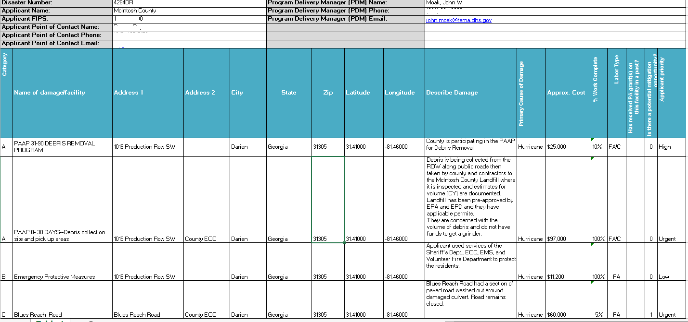
Phase I – Operational Planning
Action Items
Damage Inventory Sample
Notes:
Instructor Notes:
Have the Participants open the Damage Inventories in the Course Toolbox.
Review all the components and discuss the PDMG Roles throughout.
Show the example of the “Good” and the “Bad” inventories

Slide 45

Phase I – Operational Planning
Action Items
Activity Time:
- Gain Access to Demo Grants Portal Site
- Create a Robust Damage Inventory
Notes:
Instructor Notes:
Have the Participants open the Damage Inventories in the Course Toolbox.
Review all the components and discuss the PDMG Roles throughout.
Show the example of the “Good” and the “Bad” inventories

Slide 46
FEMA’s Public Assistance
Grants Portal
Users must download FREE Firefox Web Browser before accessing the DEMO Grants Portal Site:
https://www.mozilla.org/en-US/firefox/new/

Slide 47
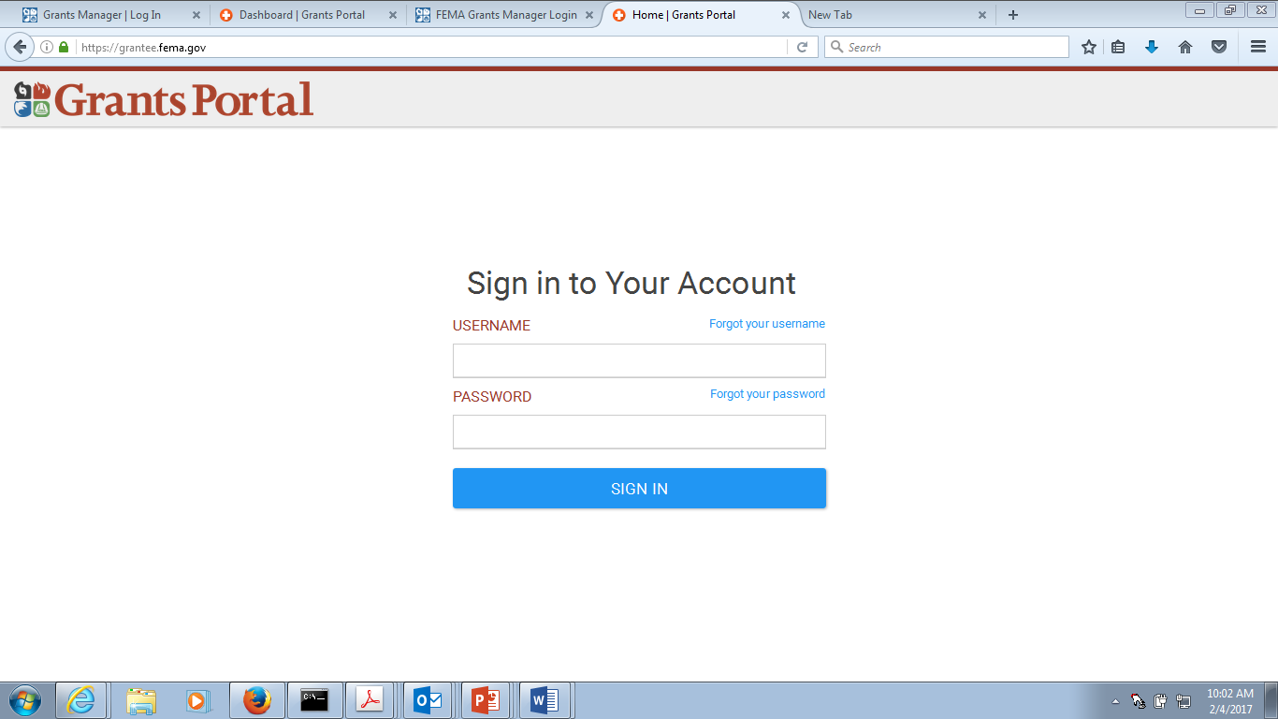
https://grantsportal-demo-site.azurewebsites.net
Instructor will give you an individual username.
Password: patraining123!

Slide 48
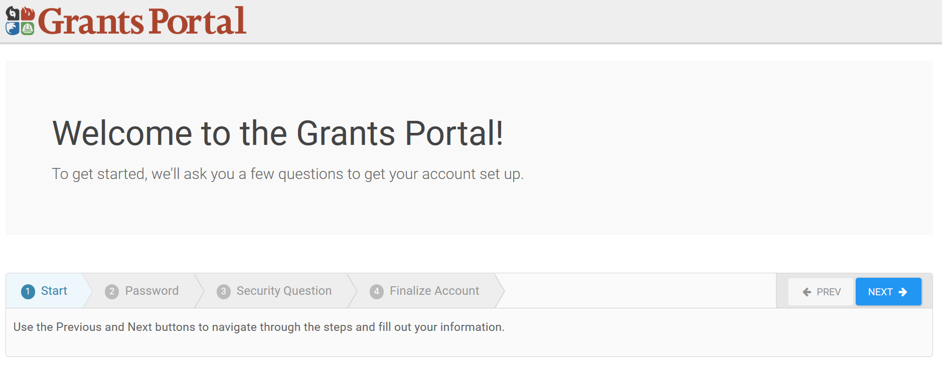
Grants Portal – Account Set up

Slide 49
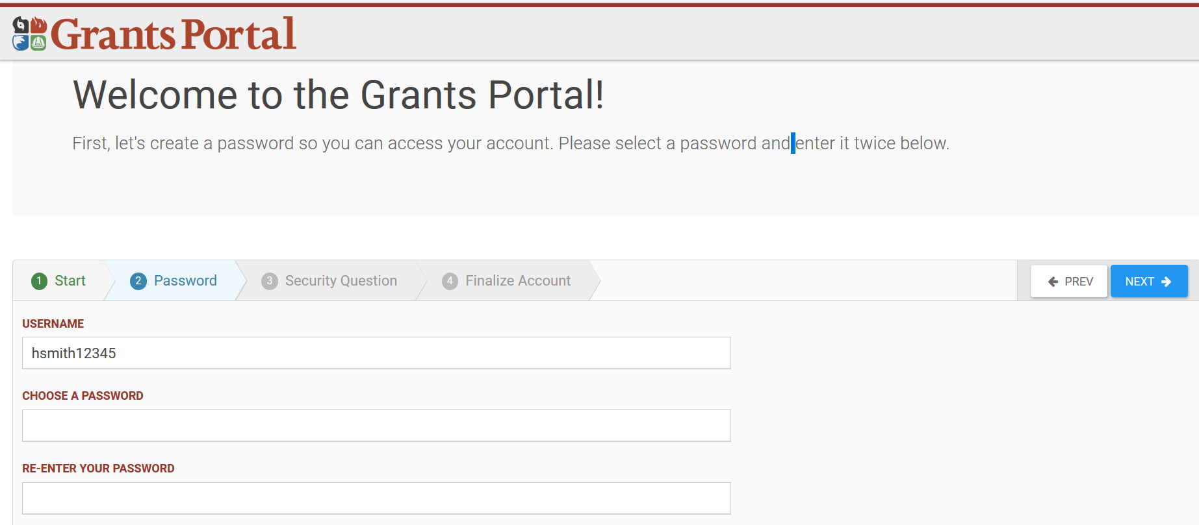
Grants Portal – Account Set up

Slide 50
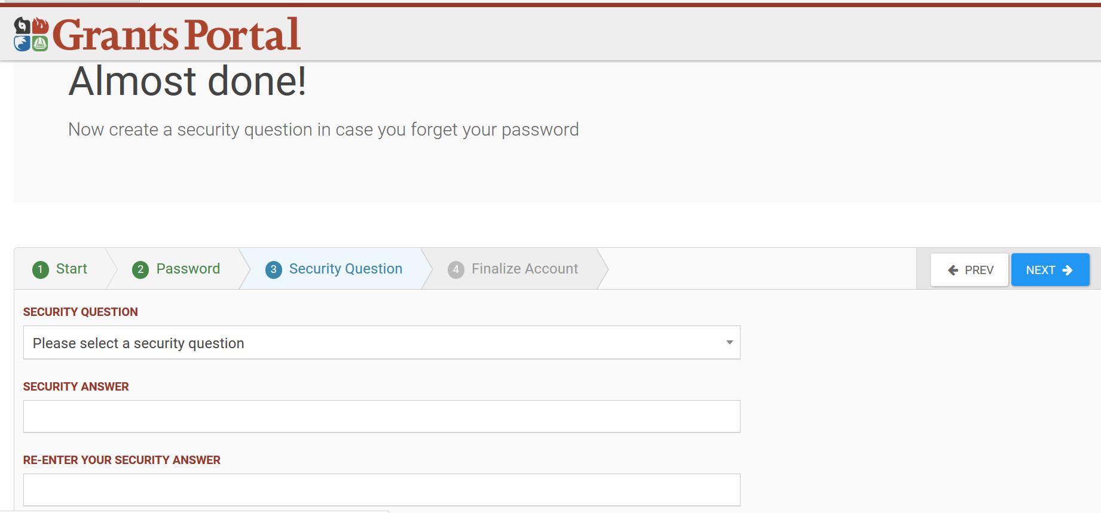
Grants Portal – Account Set up

Slide 51
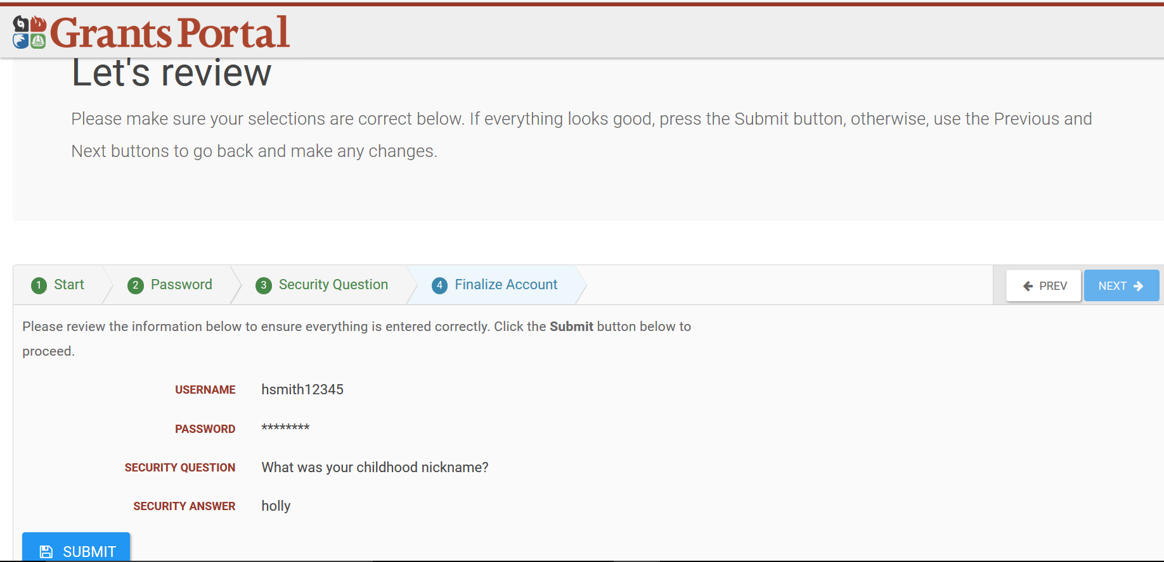
Grants Portal – Account Set up

Slide 52
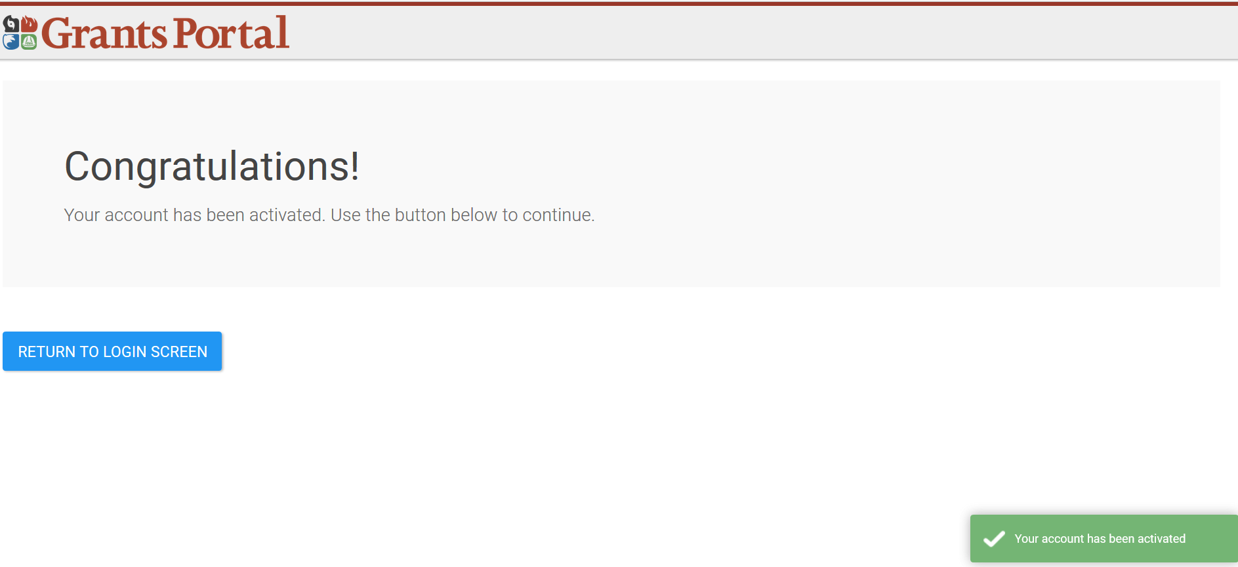
Grants Portal – Account Set up

Slide 53
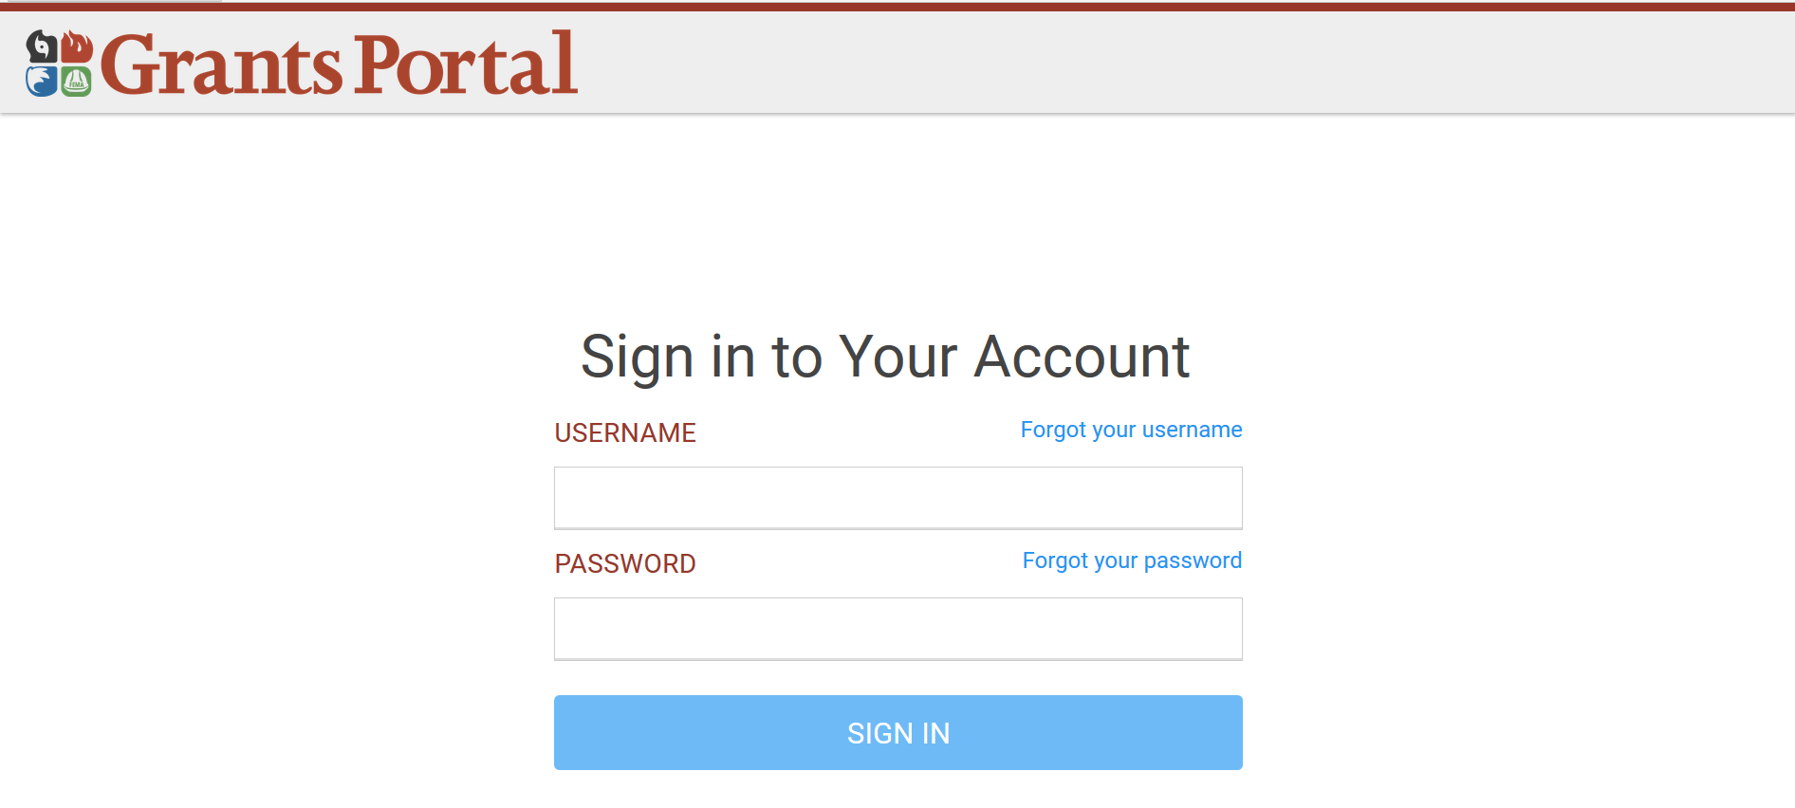
https://grantsportal-demo-site.azurewebsites.net
Login using the information you just updated/reset.

Slide 54
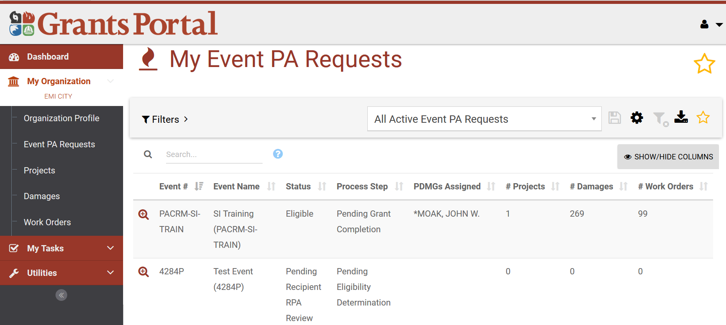
Under “My Organization” click “Event PA Requests” and select CO-EOC by clicking the magnifying glass 🔍 on the left

Slide 55
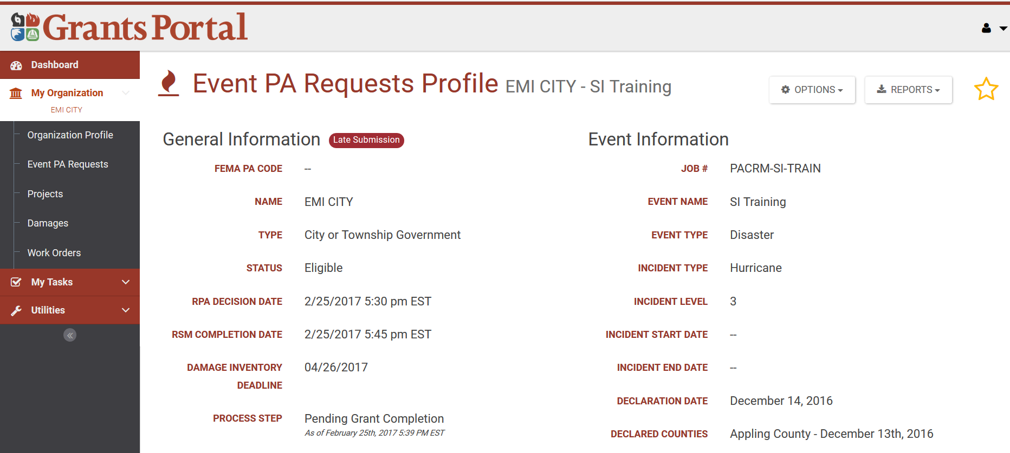
Review the “Event PA Requests Profile”

Slide 56
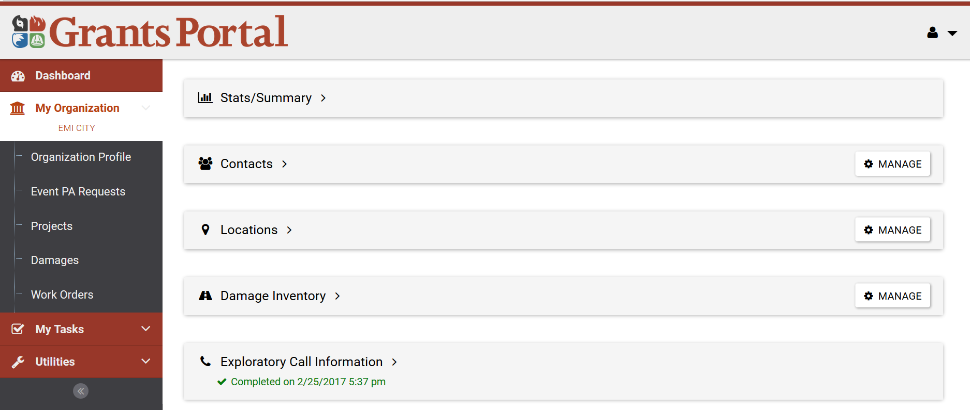
Scroll down and click the “Manage” button to the right of the “Damage Inventory” bar

Slide 57
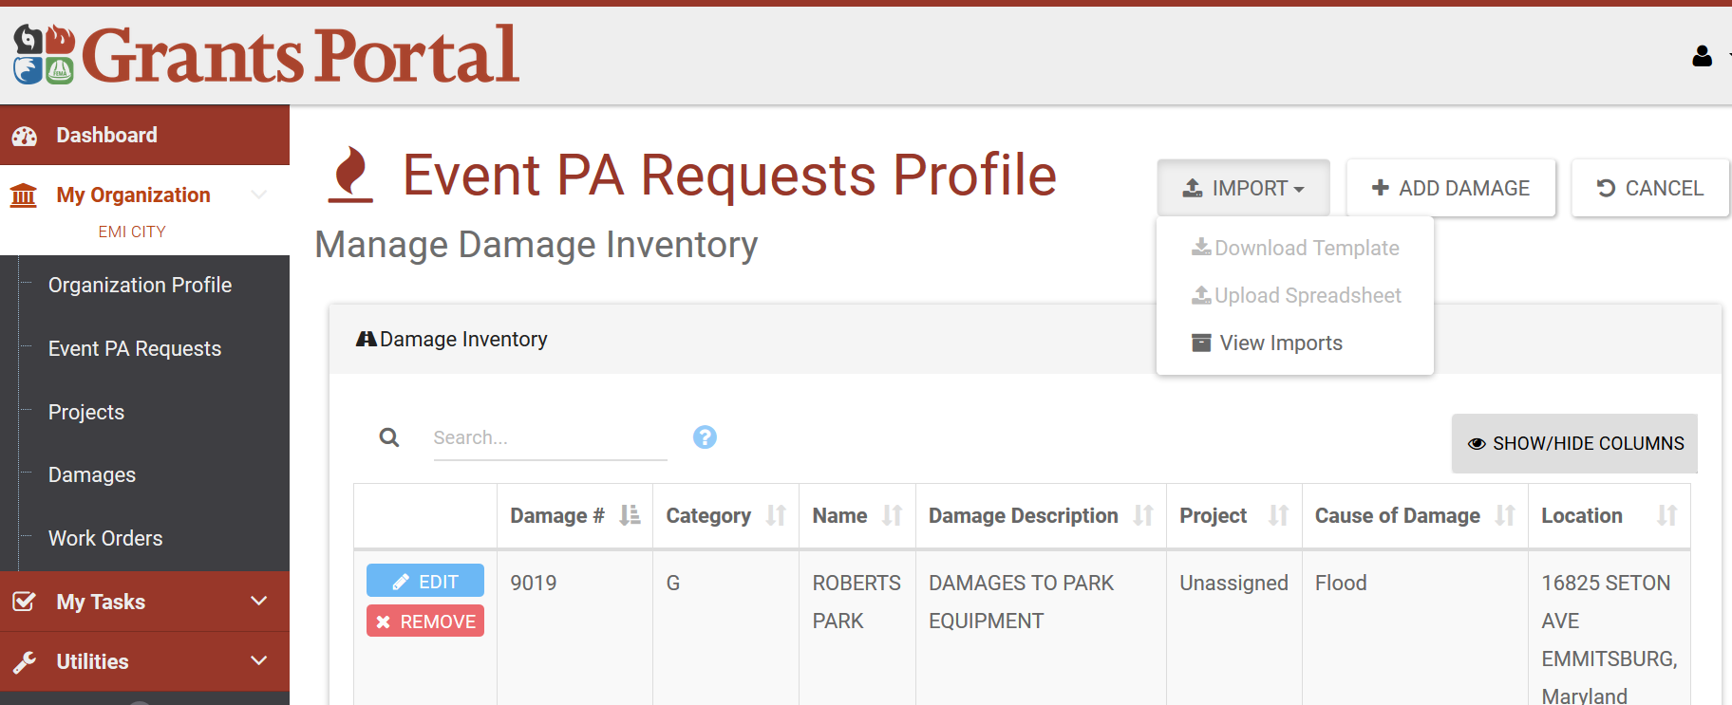
Click the Import down and select Download Template

Slide 58
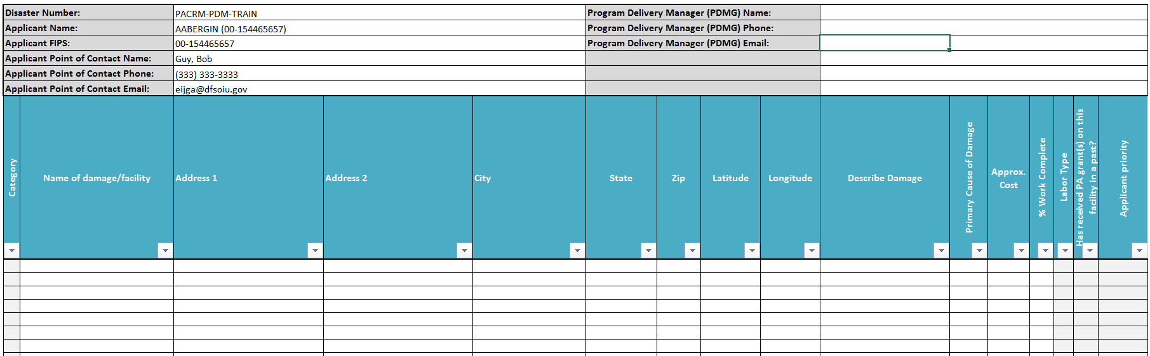
Enter 5 Items in DI Spreadsheet & Save Excel File to Desktop

Slide 59
Click “Upload Spreadsheet” button and
Search Desktop for DI Spreadsheet by “File name” in pop-up

Slide 60
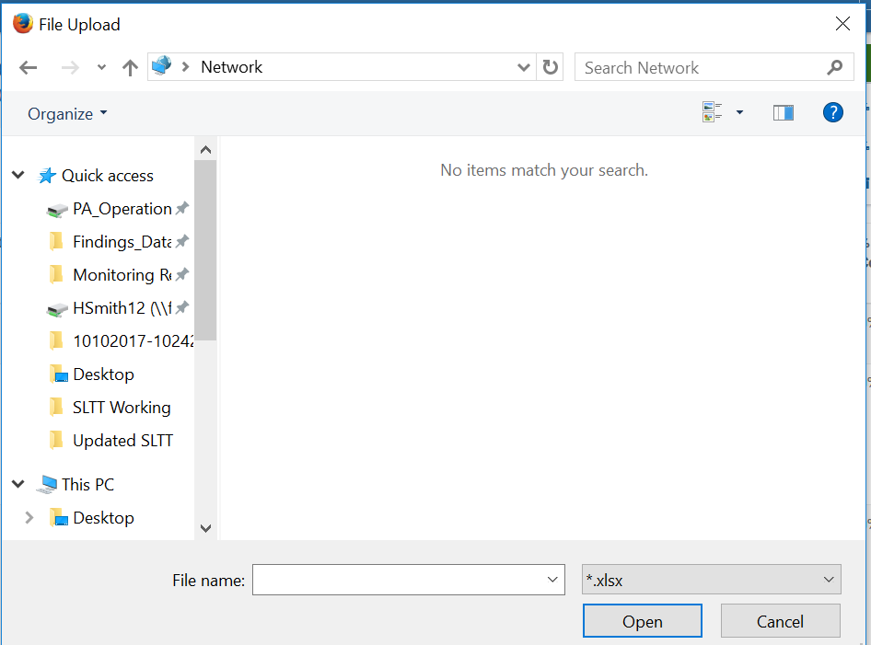
Click “Upload Spreadsheet” button and
Search Desktop for DI Spreadsheet by “File name” in pop-up

Slide 61
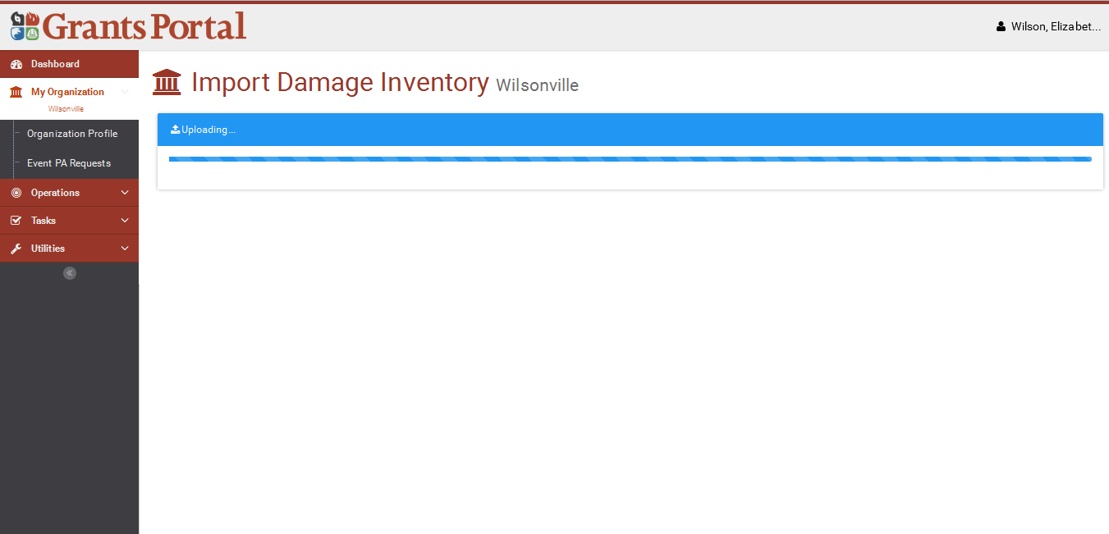
“Uploading…” Screen

Slide 62
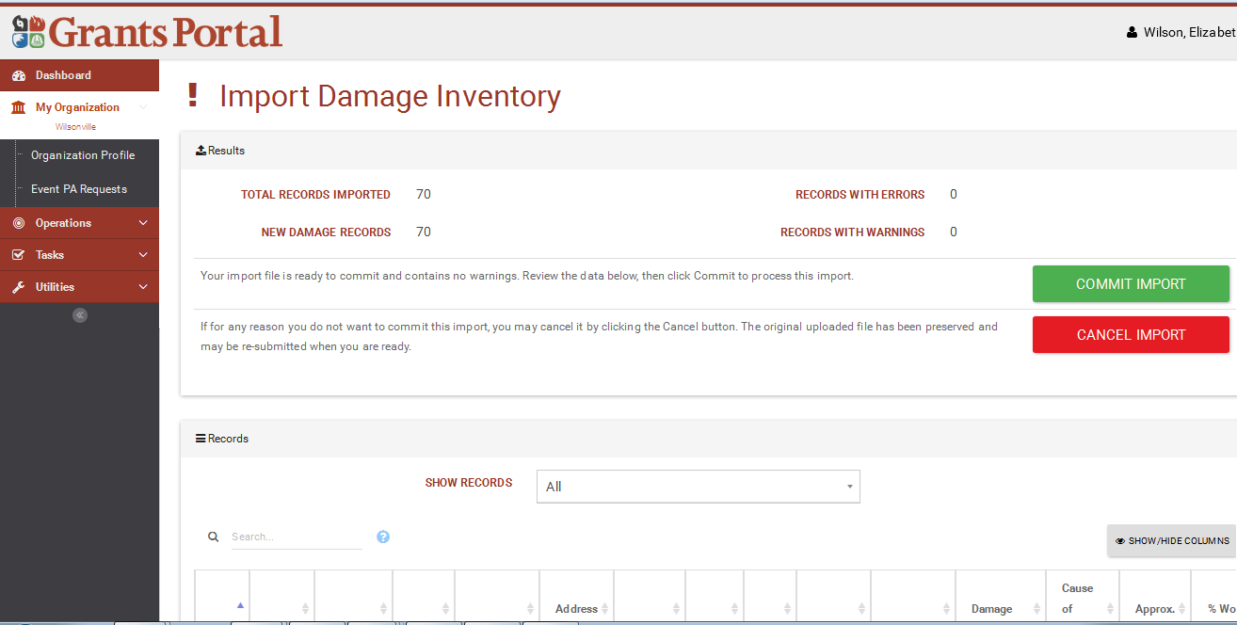
Click green “Commit Import” button

Slide 63
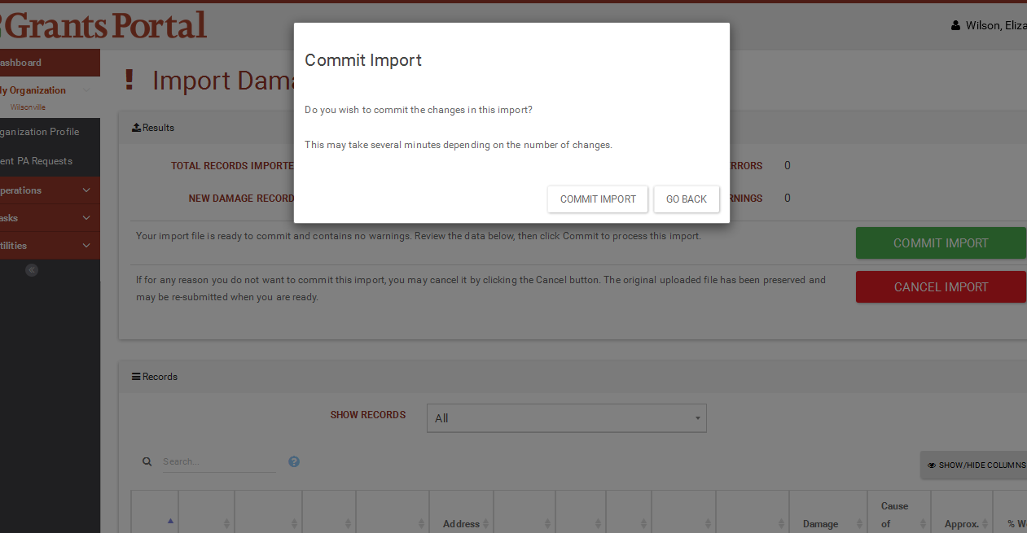
Click “Commit Import” button in pop-up box

Slide 64
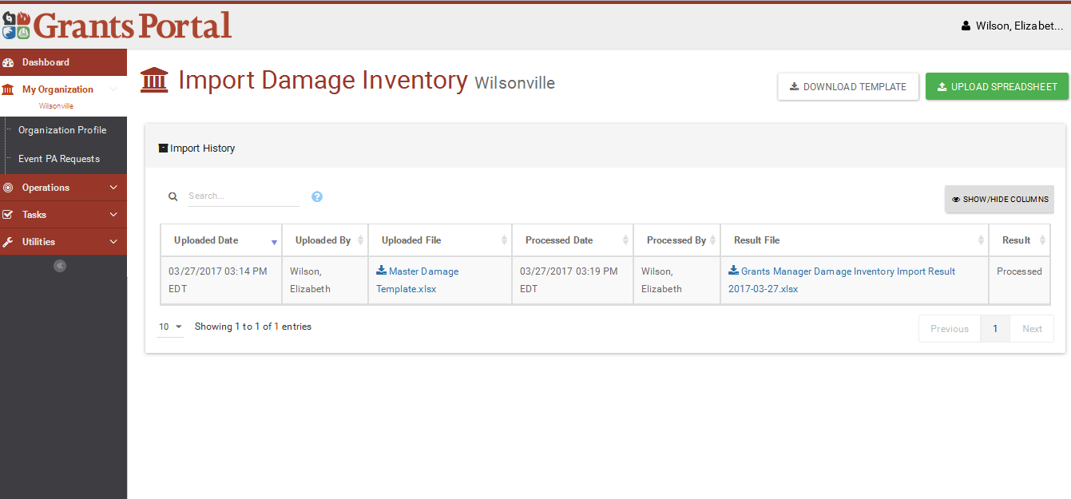
Your “Imported Damage Inventory” will appear in the list

Slide 65
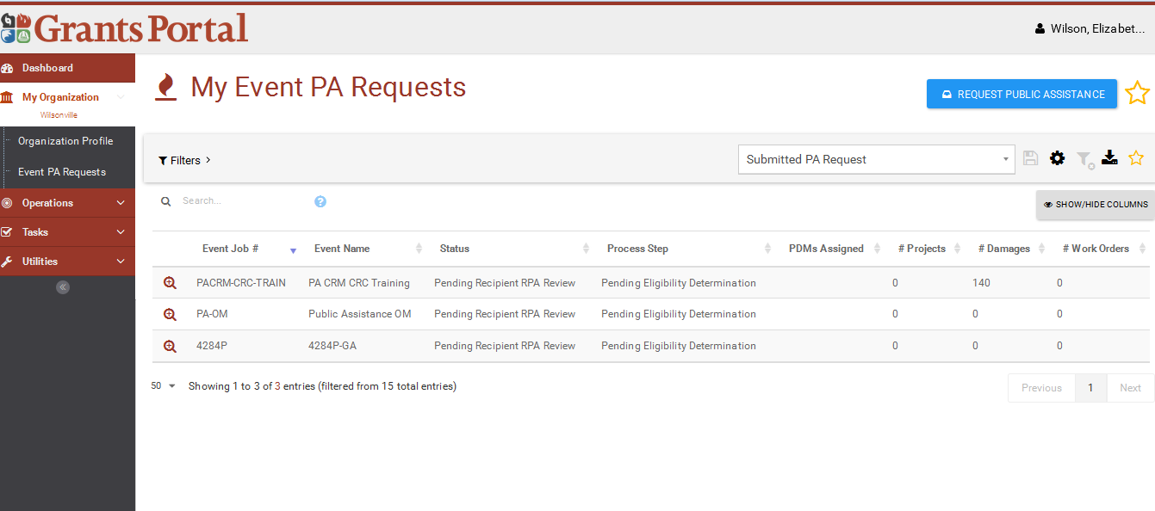
To Edit/Remove/Add Damages go back to “My Organization” click “Event PA Requests” select CO-EOC magnifying glass

Slide 66
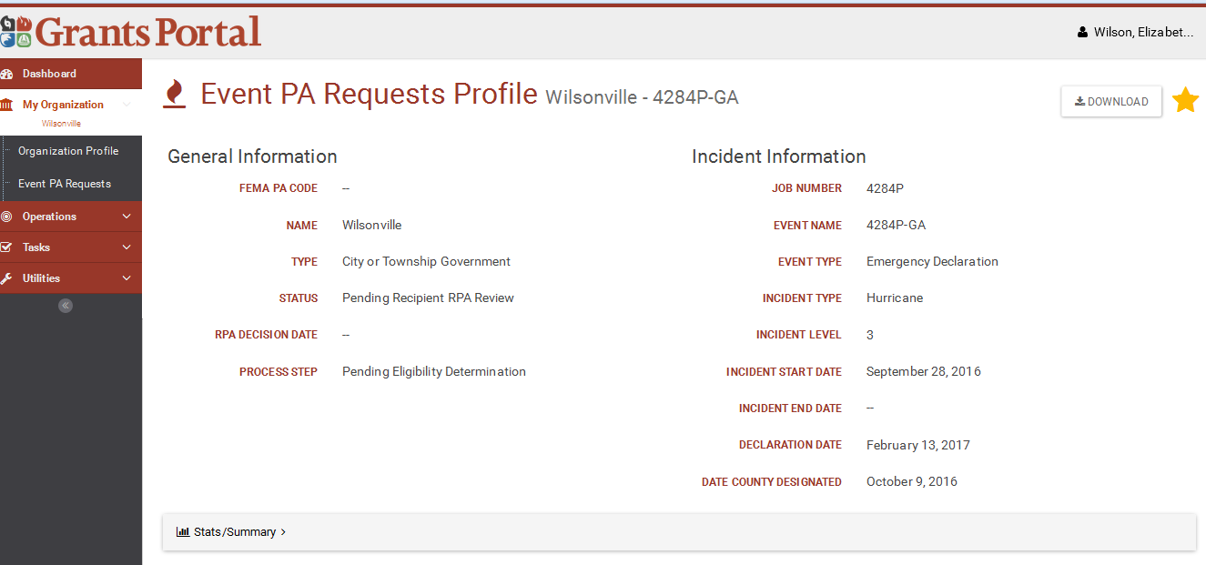
Scroll down under the “Event PA Requests Profile”

Slide 67
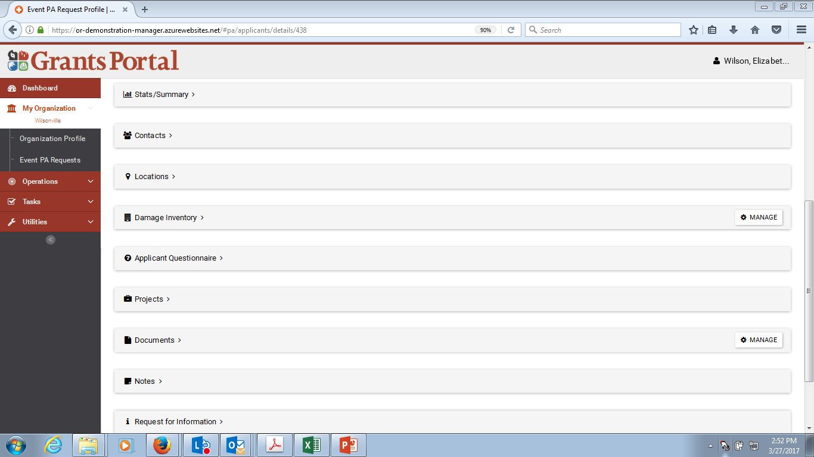
Click “Manage” button to the right of “Damage Inventory” bar

Slide 68
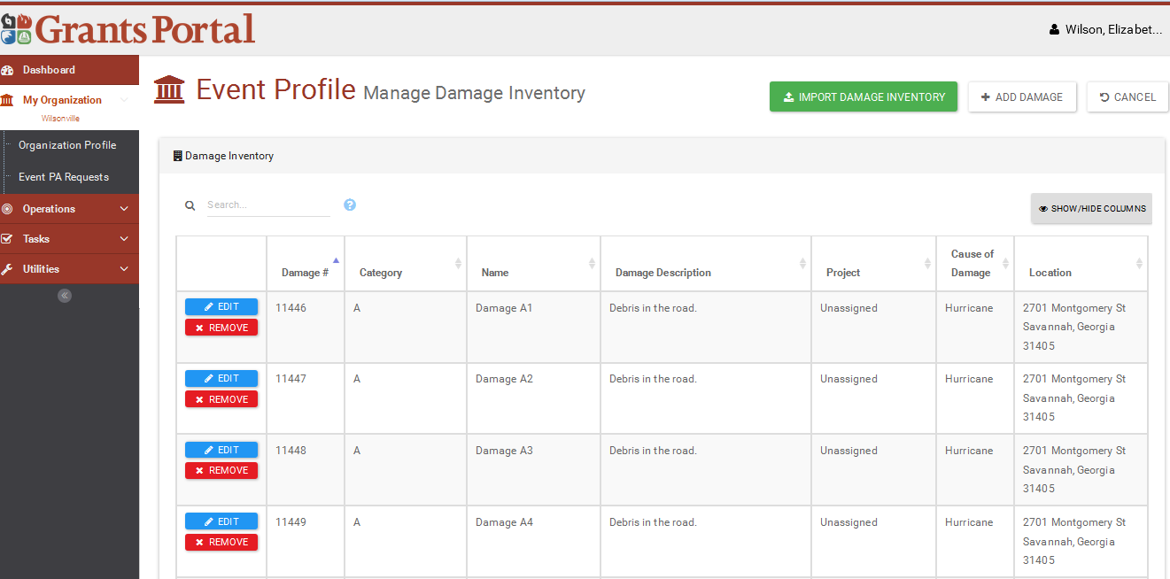
Review your uploaded Damage Inventory Items & utilize white “Add Damage” button to create 1 additional item on your own

Slide 69
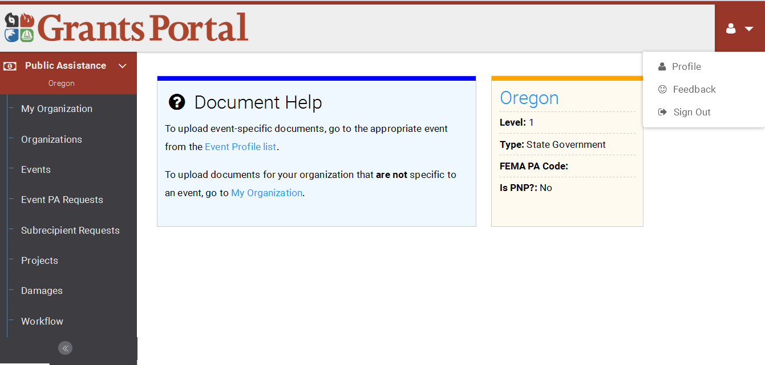
Once Damage Inventory exercise is complete, go ahead and sign out of your new Demo Grants Portal Account

Slide 70
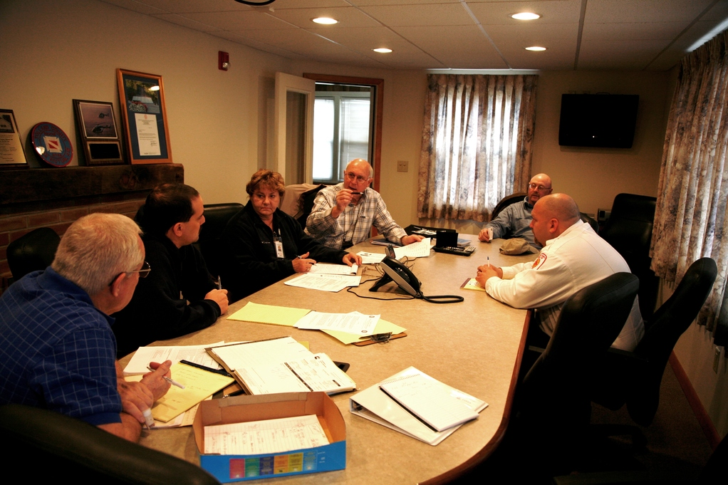
Phase I – Operational Planning
Action Items
Step 9: The Recovery Scoping Meeting
RECOVERY SCOPING MEETING VIDEO
https://www.youtube.com/watch?v=Kt0-RHwVEBU&feature=youtu.be
Notes:
Instructor Notes:
- Show the Video to the class by clicking the link.

Slide 71




Phase I – Operational Planning
Action Items
Step 8: The Recovery Scoping Meeting
OCCURS WITHIN 21 DAYS
Work on completing Damage Inventory

Slide 72
Phase I – Operational Planning
Action Items
Step 9: The Recovery Scoping Meeting
Activity – Recovery Scoping Meeting Guide and Checklist
Notes:
Instructor Notes:
- Have the Participants open the Guide. Review all the components and discuss the PDMG Roles throughout.

Slide 73
Phase I – Operational Planning
Action Items
The Recovery Scoping Meeting
Key Action Items:
Ensure the Damage Inventory is complete in the Grants Portal.
Full review of itemized damage sites and Applicant considerations.
Consider logical groupings of damages into projects.
Discuss any potential Special Considerations to include: Insurance, Mitigation, and Environmental/Historic compliance.
Notes:
Instructor Notes:
Remind the course attendees that the Applicant will have 60 days from the Recovery Scoping meeting to identify damage. However, all known damages will need to be captured in the Damage Inventory prior to the conclusion of the RSM. The PDMG will assist the Applicant with any Grants Portal technical issues in the process and/or load the Damage Inventory for Applicants who lack internet capability.
The Program Delivery Manager, with assistance from the Recipient, will review the damage sites with the Applicant.
The FEMA Program Delivery Manager will work to collect and download the Applicant's entire Insurance Policy prior to the conclusion of the Scoping Meeting.
406 Hazard Mitigation and EHP staff will be on hand ***if available*** to address potential Mitigation Proposals from the Applicant. EHP Staff will work to identify any potential compliance considerations/needs.
SPECIAL INSTRUCTOR NOTE: Remind attendees that Hazard Mitigation opportunities come in the form of proposals from the Applicant, to repair sites through methods that reduce the potential for future damage.
SPECIAL INSTRUCTOR NOTE: Emphasize that Mitigation and EHP considerations may take additional time to address. Therefore, it is critical that any 406 Mitigation opportunities and/or Environmental/Historic compliance considerations are identified as early in the process as possible.

Slide 74
Phase I – Operational Planning
Action Items
The Recovery Scoping Meeting
Key Action Items (Continued):
Review Category Specific Appendices (Per RSM Guide and Checklist) to discuss questions and document requirements.
Establish Applicant availability for Site Inspections
Site Inspections are ordered by the Program Delivery Manager
Develop the Program Delivery Plan.
Notes:
Instructor Notes:
Work Completed versus Work to be Completed needs to be identified prior to completion to the meeting. The identification is critical to the scheduling and ordering of Site Inspections, and will play an important role in the Project Lane identification process.
At the time of the Recovery Scoping Meeting, it is determined that project work will be completed in less than two (2) weeks, the damaged site will be categorized as Work Complete.
Applicants will need to identify availability for the scheduling of site Inspections.
In Scheduling Site Inspections, the Applicant will need to ensure that their designated representative (example: Highway Supervisor) is available at the time and date the inspections are scheduled.
Special Instructor Note: As a reminder, the Recipient is invited to be an active participant and partner through all of the Recovery Scoping Meeting activities. In addition, the Recipient is invited to participate in all future meetings and/or Site Inspections. Recipient availability is also a consideration in scheduling
Scheduling considerations of personnel are an additional consideration for potential Applicant attendees at the Recovery Scoping Meeting.
The Program Delivery Manager will assist the Applicant with Document Download, and coach the Applicant through the assembly of required documents from the point of the Scoping Meeting moving forward. Document collection and disclosure will be achieved through the use of the Document Checklists.

Slide 75
Phase I – Operational Planning
Action Items
The Recovery Scoping Meeting
The Program Delivery Plan.
30-45 Day initial plan between the Applicant and PDMG
Schedules regular follow-up meetings (Minimum Weekly)
Addresses scheduled Site Inspections
Identifies Applicant Points of Contact (POC) for respective projects
Establishes target timelines based on Applicant priorities and documentation disclosure.
Identifies dates to ensure regulatory compliance.
Notes:
Instructor Notes:
Work Completed versus Work to be Completed needs to be identified prior to completion to the meeting. The identification is critical to the scheduling and ordering of Site Inspections, and will play an important role in the Project Lane identification process.
At the time of the Recovery Scoping Meeting, it is determined that project work will be completed in less than two (2) weeks, the damaged site will be categorized as Work Complete.
Applicants will need to identify availability for the scheduling of site Inspections.
In Scheduling Site Inspections, the Applicant will need to ensure that their designated representative (example: Highway Supervisor) is available at the time and date the inspections are scheduled.
Special Instructor Note: As a reminder, the Recipient is invited to be an active participant and partner through all of the Recovery Scoping Meeting activities. In addition, the Recipient is invited to participate in all future meetings and/or Site Inspections. Recipient availability is also a consideration in scheduling
Scheduling considerations of personnel are an additional consideration for potential Applicant attendees at the Recovery Scoping Meeting.
The Program Delivery Manager will assist the Applicant with Document Download, and coach the Applicant through the assembly of required documents from the point of the Scoping Meeting moving forward. Document collection and disclosure will be achieved through the use of the Document Checklists.

Slide 76

Questions
Notes:
Conclusion of Unit – Take brief moment to address any final questions before proceeding.

Slide 77

Conclusion of Unit 3
Course Evaluation and Comment
Notes:
Instructor Notes:
Have students complete the Unit 3 portion of the evaluation. Include time for comments and feedback.

